Slide 1
REAL-TIME YOGA POSTURE PREDICTION AND CORRECTION
Project guide:
Ms. AMRUTHA KARTHIKEYAN
Assistant Professor
Department of MCA
UC College, Aluva
ANUGRAH N.P
4C-11

Slide 2
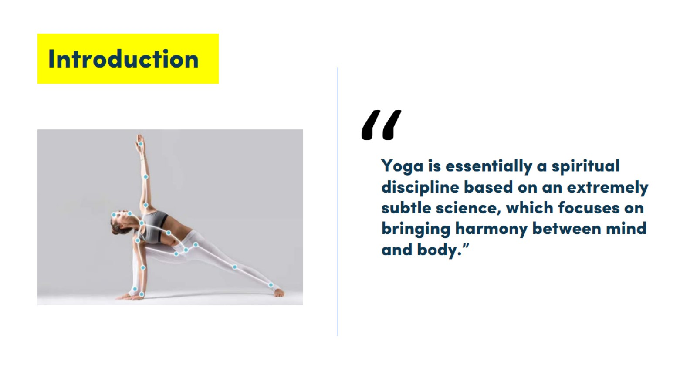
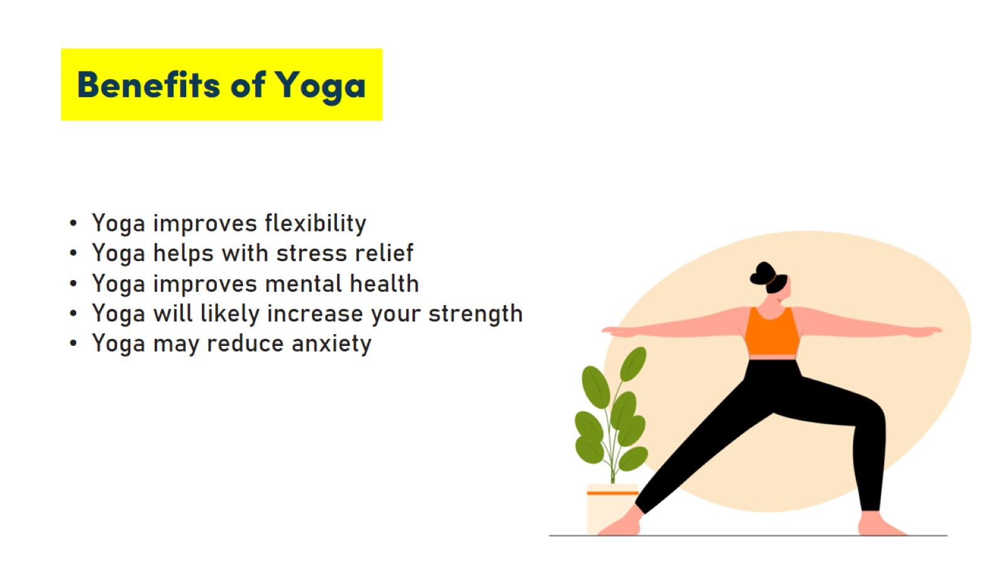
INTRODUCTION
BENEFITS OF YOGA
Yoga improves flexibility.
Yoga helps with stress relief
Yoga improves mental health
Yoga will likely increase your strength
Yoga may reduce anxiety

Slide 3
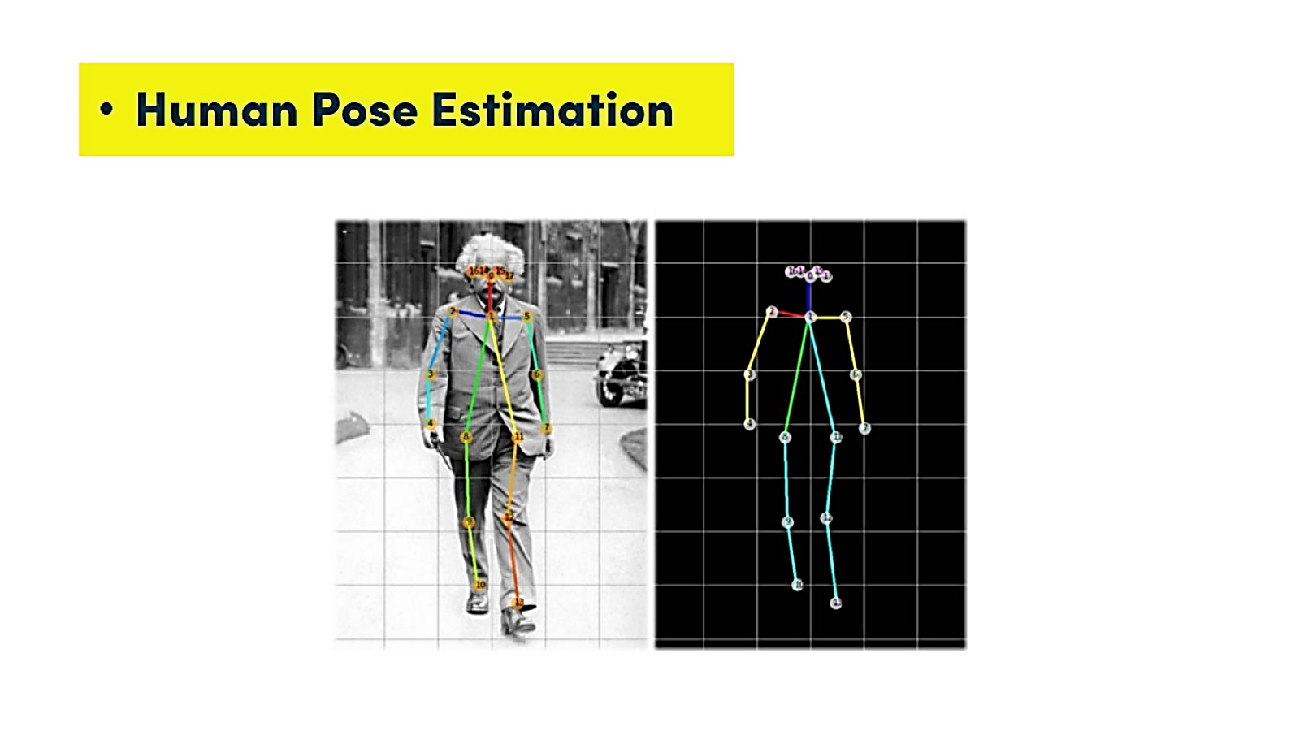
INTRODUCTION
Incorrect posture while performing yoga can lead to serious harm to muscles and ligaments of the body.
Our approach aims to automatically recognize the user’s Yoga poses in real-time and provide concise feedback to the practitioner.
Mediapipe algorithm extracts body landmarks of each of the key points to enable angle calculation of each body joint.
So that proper instructions can be delivered to help them in a very convenient manner so that they can adjust their poses and learn about their incorrectness in real-time.

Slide 4
MODULES
1
Registration and selecting a pose
2
Pose Estimation
3
Pose Comparison
4
Pose Classification
5
Feedback

Slide 5
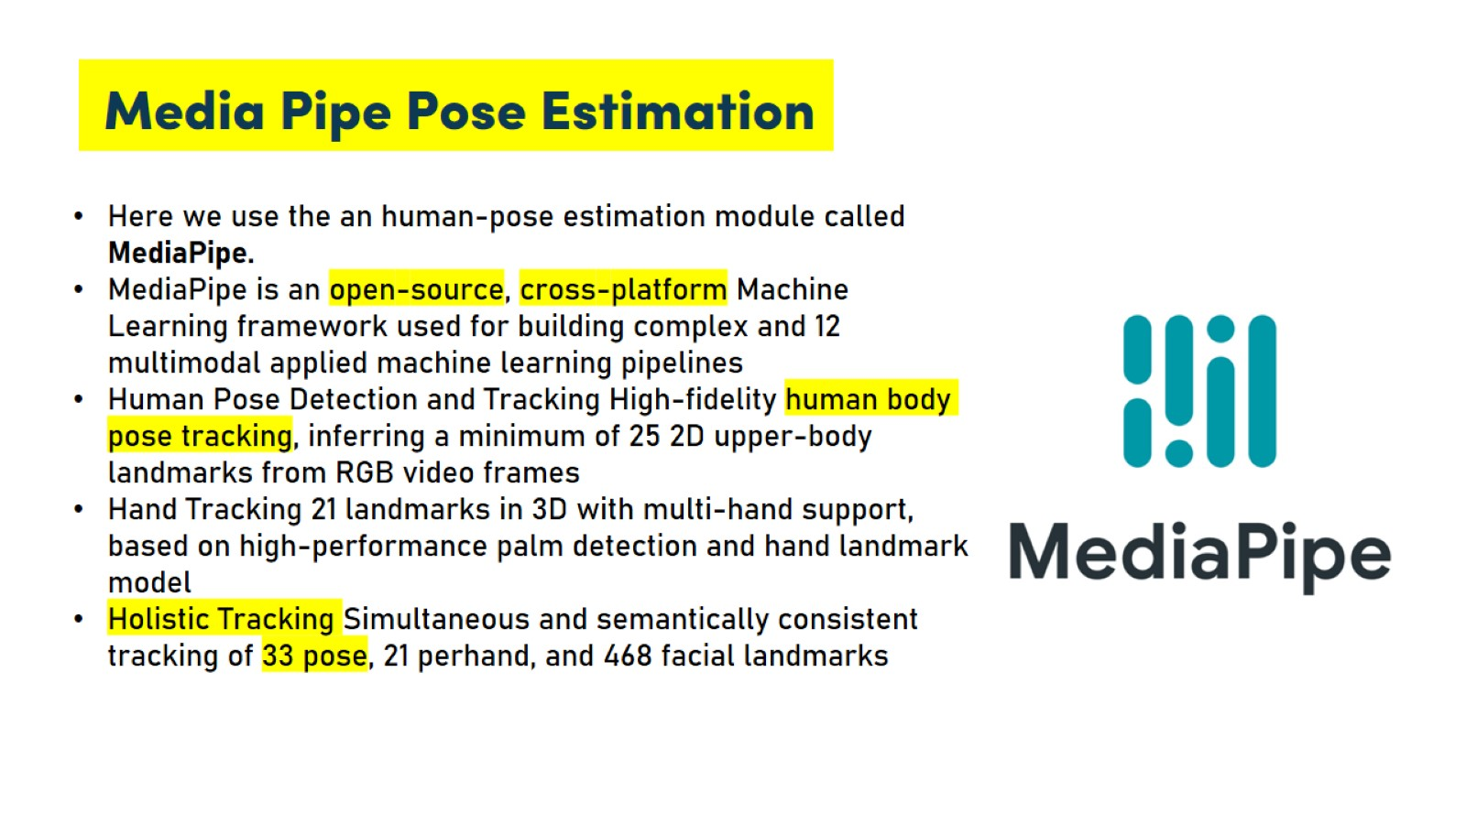
1. Registration and Selecting Pose
We need to register an account and login into the webpage.
Checking credentials, we will be moving to a page with 6 yoga poses mentioned.
Select any pose to try and perform.
Webcam will be opened as a result and can perform in front of it.
2. Pose Estimation
Media Pipe is a framework for high-fidelity body pose tracking.
It takes input from RGB video frames and infers 33 3D landmarks on the whole human.
Mediapipe algorithm extracts body landmarks of each of the keypoints to enable angle calculation of each body joint.

Slide 6
3. Pose Comparison
The output from the MediaPipe library only contains the coordinates of the user’s major key points in the image.
A function is written in the program to get these coordinates data and then calculate the angles at each joint.
Given three key-points we can easily calculate the angle made between the two lines using analytic geometry.
4. Pose Classification
A function is created, that will be capable of classifying different yoga poses using the calculated angles of various joints.
For Eg., In T Pose, the person has to stand up like a tree with both hands wide open as branches.
• Around 180° at both elbows
• Around 90° angle at both shoulders
• Around 180° angle at both knees

Slide 7
5. Feedback
Giving feedback to the user is of utmost importance so that the user knows what he/she is doing wrong.
When the user deviates beyond the threshold value the user is notified.
Users can observe the correction and make necessary adjustments to his/her pose to accurately practice the yoga routine.
The feedback can be in the form of a visual alert on the screen.

Slide 8
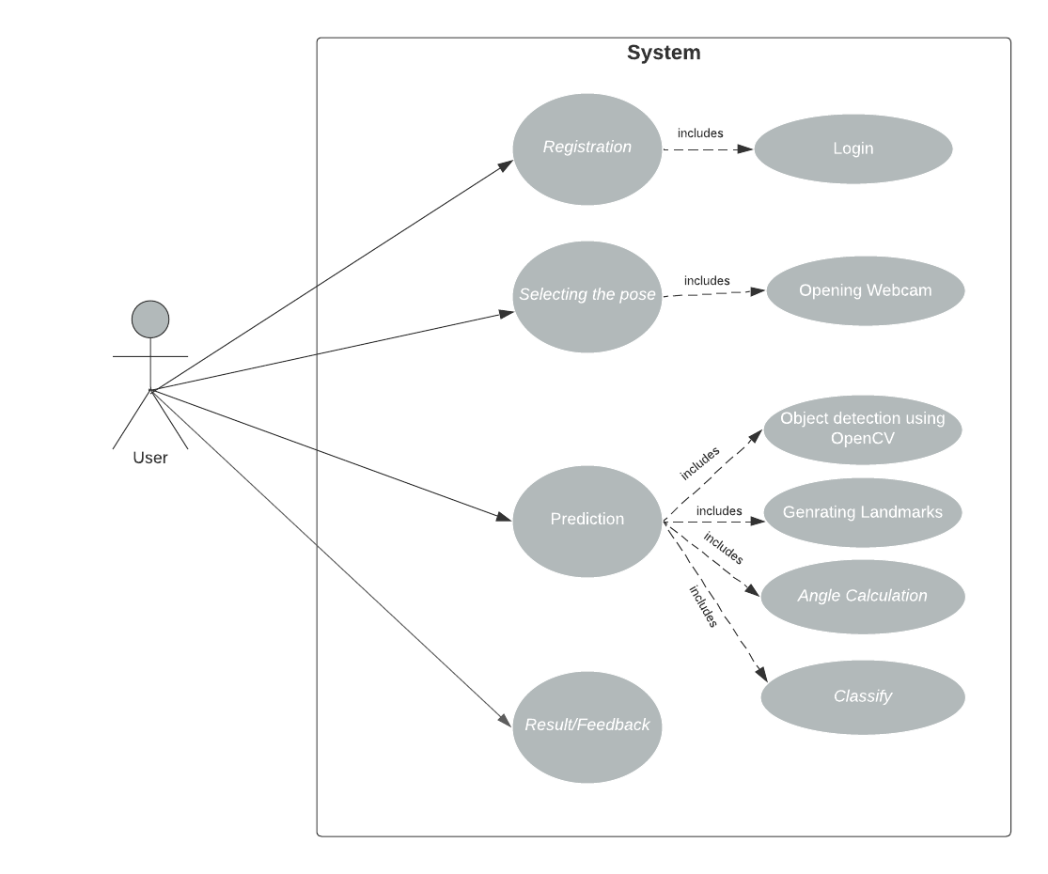
ARCHITECTURE DIAGRAMS
1. Use Case Diagram

Slide 9
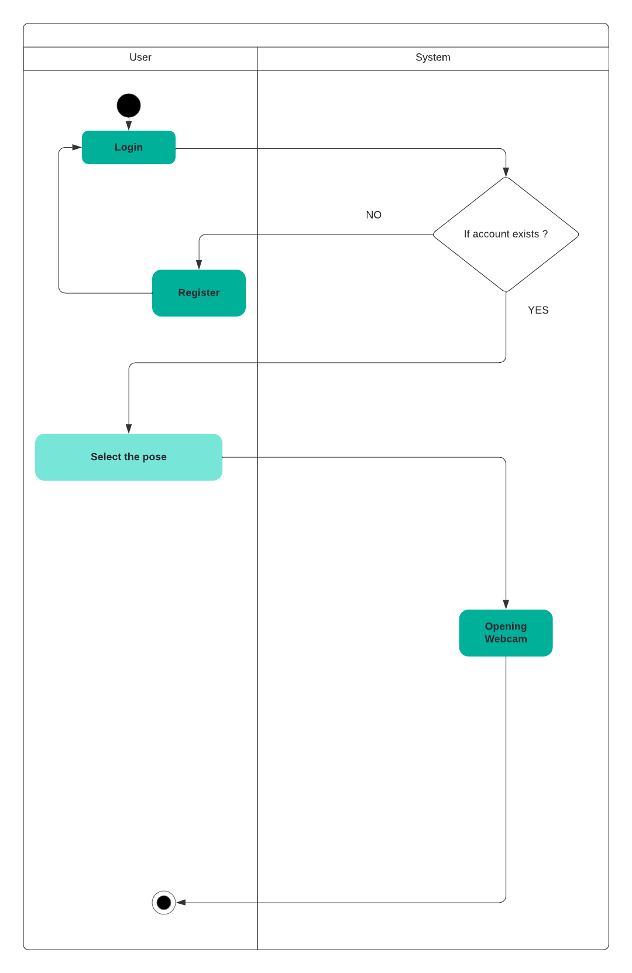
2. Activity Diagram
i: Registration

Slide 10
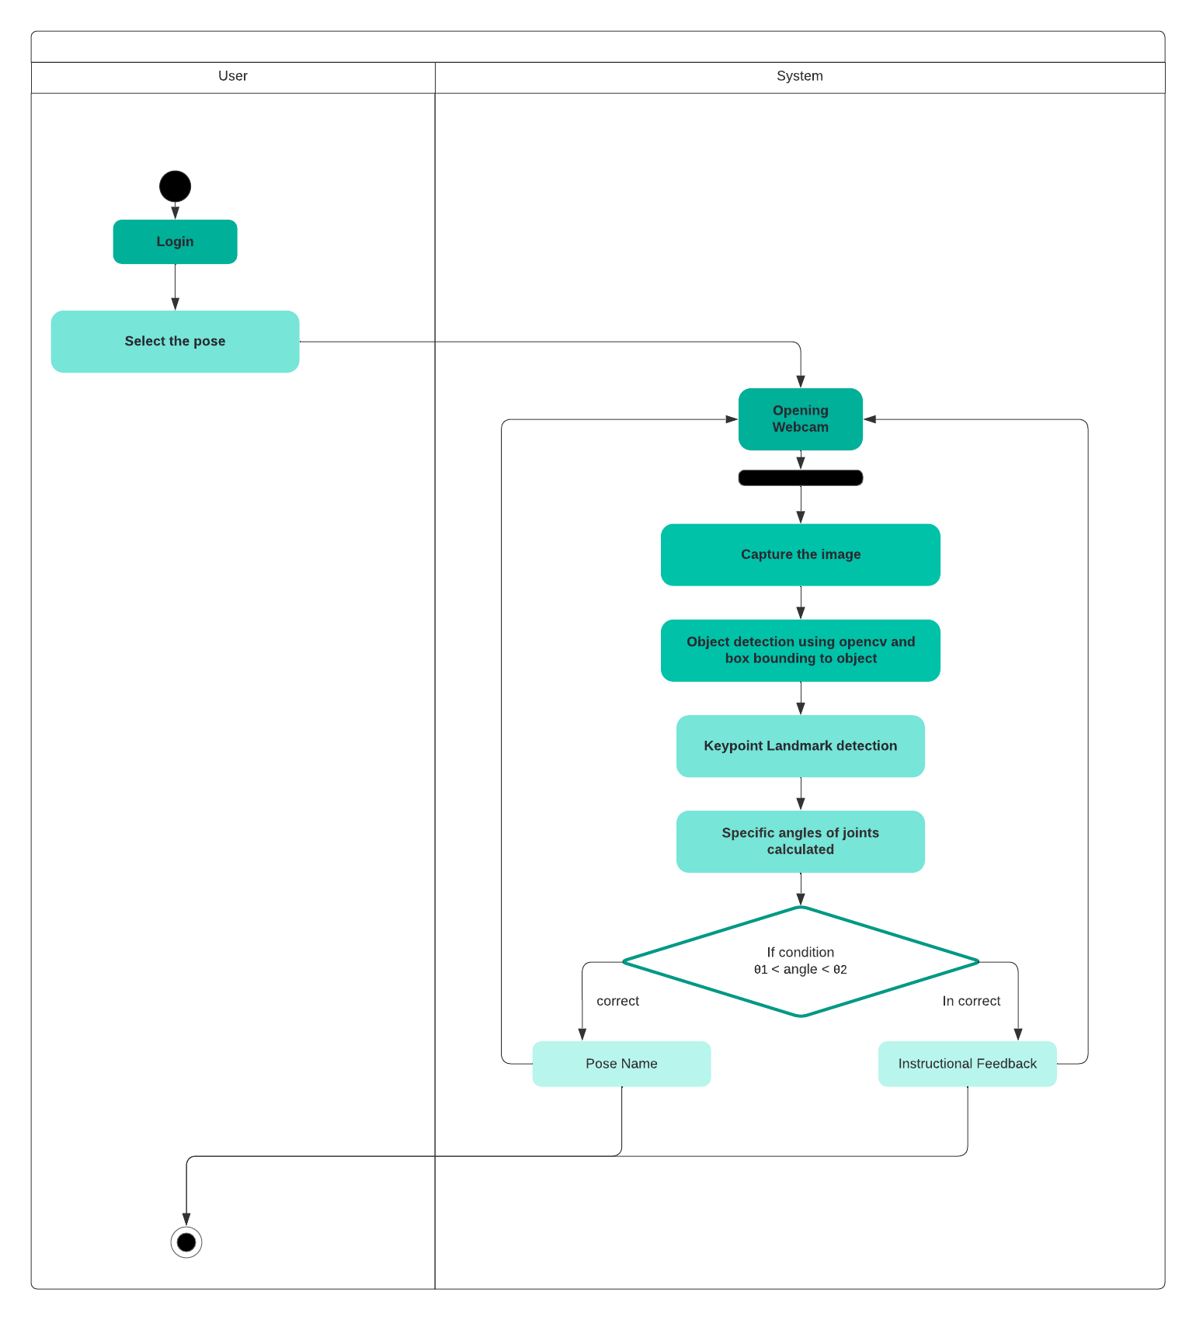
2. Activity Diagram
ii: Prediction

Slide 11
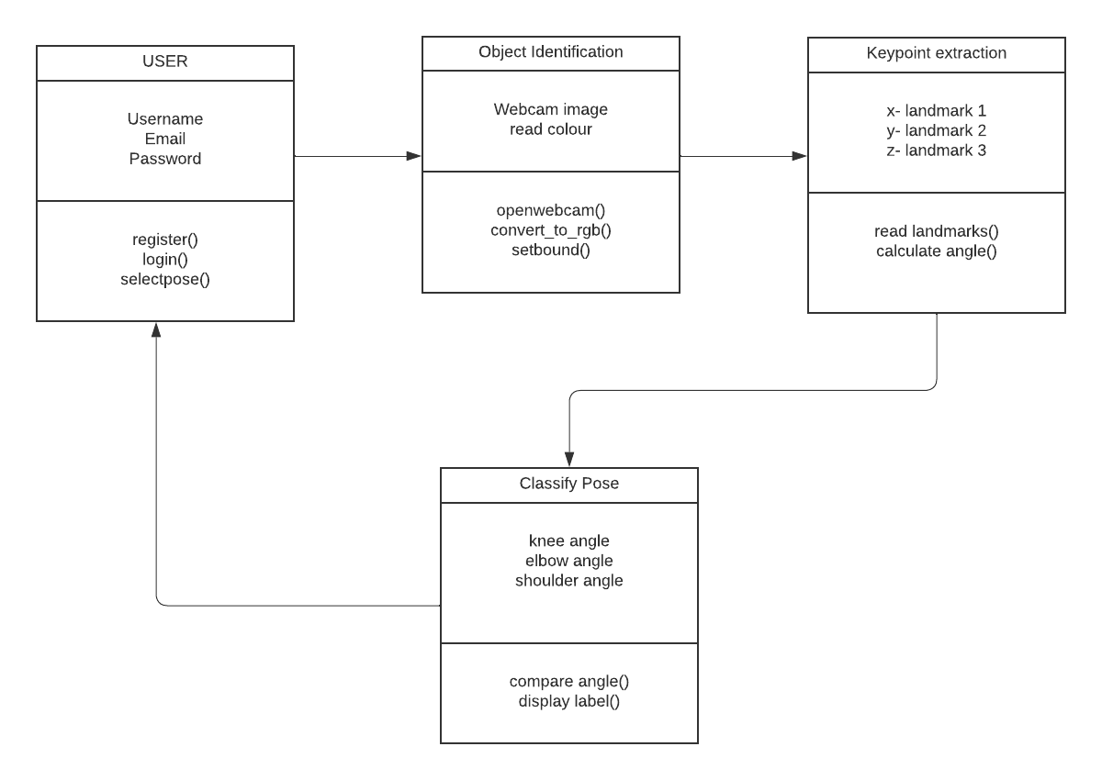
ARCHITECTURE DIAGRAMS
3. Class Diagram

Slide 12
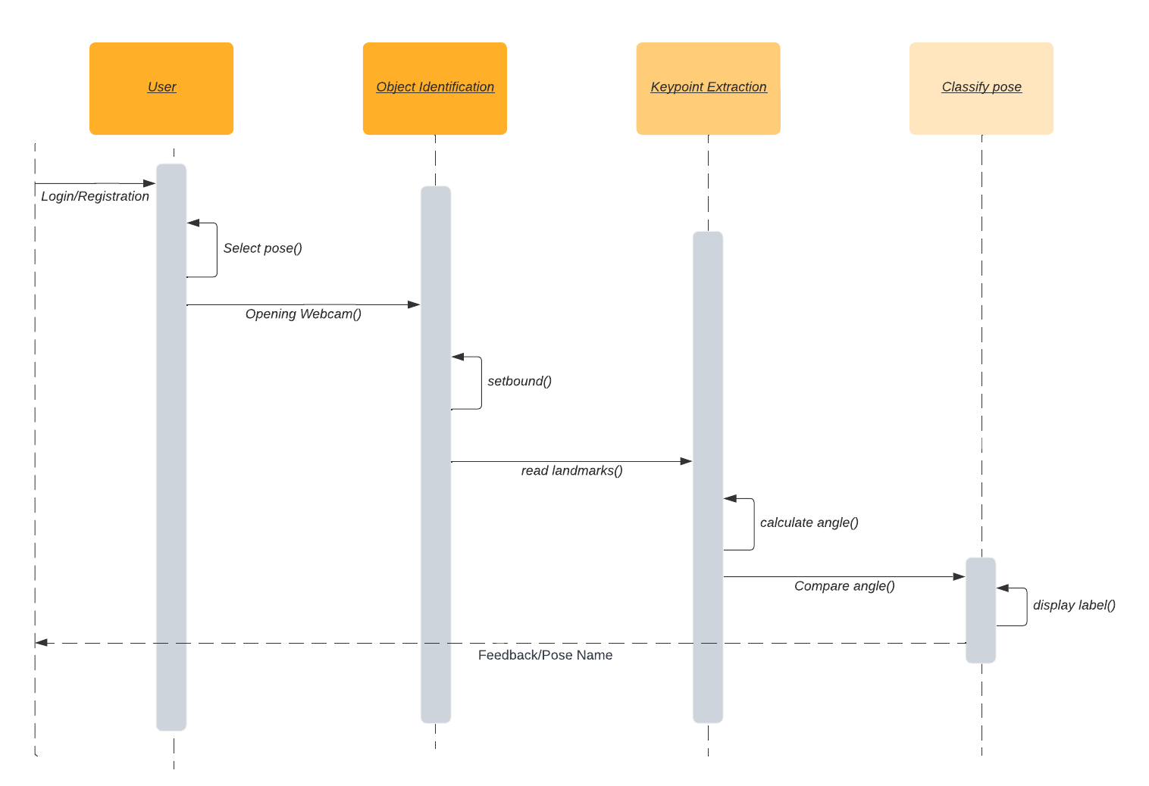
ARCHITECTURE DIAGRAMS
4. Sequence Diagram

Slide 13
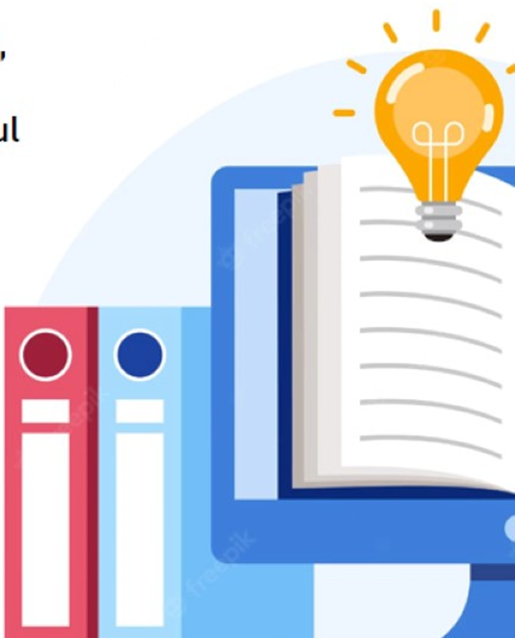
REFERENCES
[1] F. Rishan, B. De Silva, S. Alawathugoda, S. Nijabdeen, L. Rupasinghe and C. Liyanapathirana, ”Infinity Yoga Tutor: Yoga Posture Detection and Correction System,” 2020 5th International Conference on Information Technology Research (ICITR), 2020, pp. 1-6, doi10.1109/ICITR51448.2020.9310832.
[2] Agrawal, Y., Shah, Y., Sharma, A. ”Implementation of machine learning technique for identification of yoga poses”. In 2020 IEEE 9th International Conference on Communication Systems and Network Technologies (CSNT),2020, 40–43.doi:10.1109/CSNT48778.2020.9115758
[3] Anilkumar, A., K.t., A., Sajan, S., K.a., S, ”Pose Estimated Yoga Monitoring System”, SSRN Electronic Journal. doi:10.2139/ssrn.3882498 Zhang Z (2012) Microsoft kinect sensor and its effect, IEEE Multi 19:4–10. https://doi.org/10.1109/ MMUL.2012.24
[4] Chun J, Park S, Ji M ,” 3D human pose estimation from RGB-D images using deep learning method”. In: Proceedings of the 2018 International Conference on Sensor, Signal and Image Processing, 2018,pp 51–55, https://doi.org/10.1145/3290589.3290591
[5] Kadbhane,S., Datir,K., Jagdale,T., Dhongade,S., Jagtap,G.”Yoga Posture Recognition”, International Journal of Advanced Research in Computer and Communication Engineering, 2021,143–147. doi:10.17148/IJARCCE.2021.10128
[6] Girija Gireesh Chiddarwar, Abhishek Ranjane, Mugdha Chindhe ,” AI-Based Yoga Pose Estimation for Android Application”, International Journal of Innovative Science and Research Technology,2020.

Slide 14
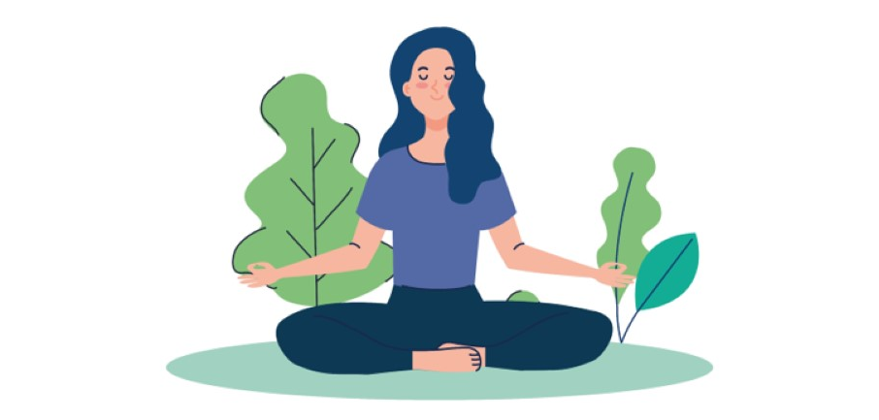
THANK YOU

